Slide 1
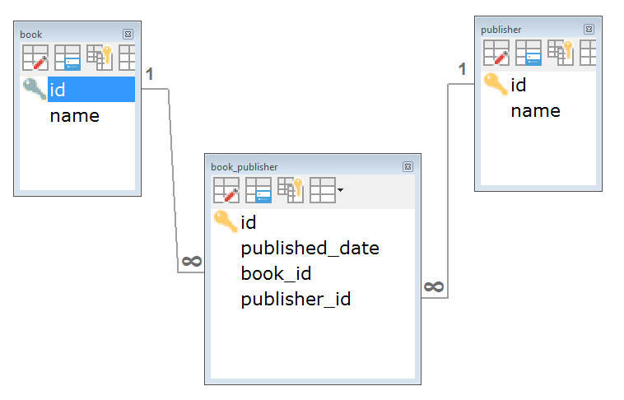
RESTful API Example with Spring Data REST, JPA and Hibernate Many to Many

Slide 2
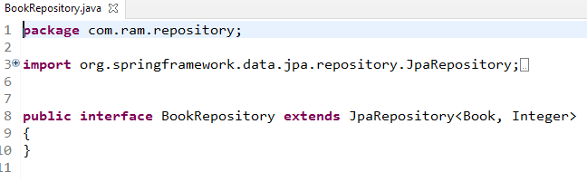
RESTful API Example with Spring Data REST, JPA and Hibernate One to Many
Spring Data JPA and Spring Data Rest will auto create some helper methods and RESTful APIs. For this example, we only need to extend JpaRepository

Slide 3
https://hellokoding.com/restful-api-example-with-spring-boot-spring-data-rest-spring-data-jpa-many-to-many-extra-columns-relationship-and-mysql/

